Slide 1
Lab issues
New lab computers
New labs and devices
Informed consent procedure
Hello / goodbye
TSG WIP (work in progress)
TSG WIKI
Manufacturing from old to new school
Programming mobile applications

Slide 2
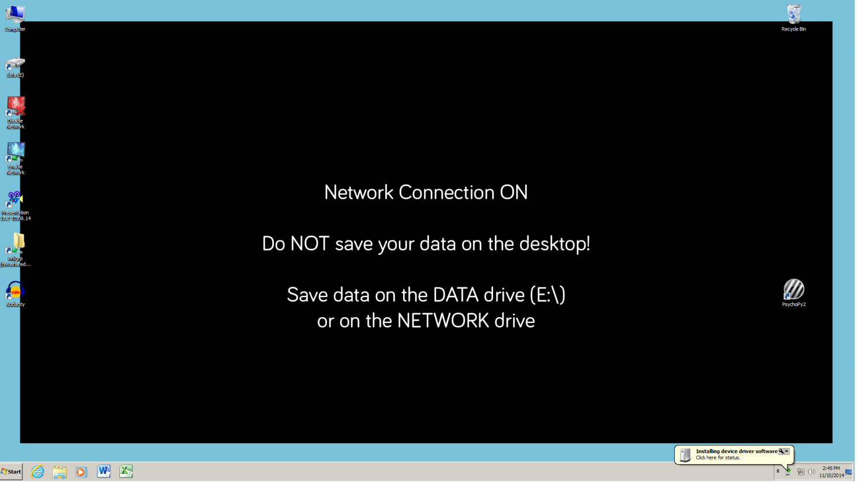
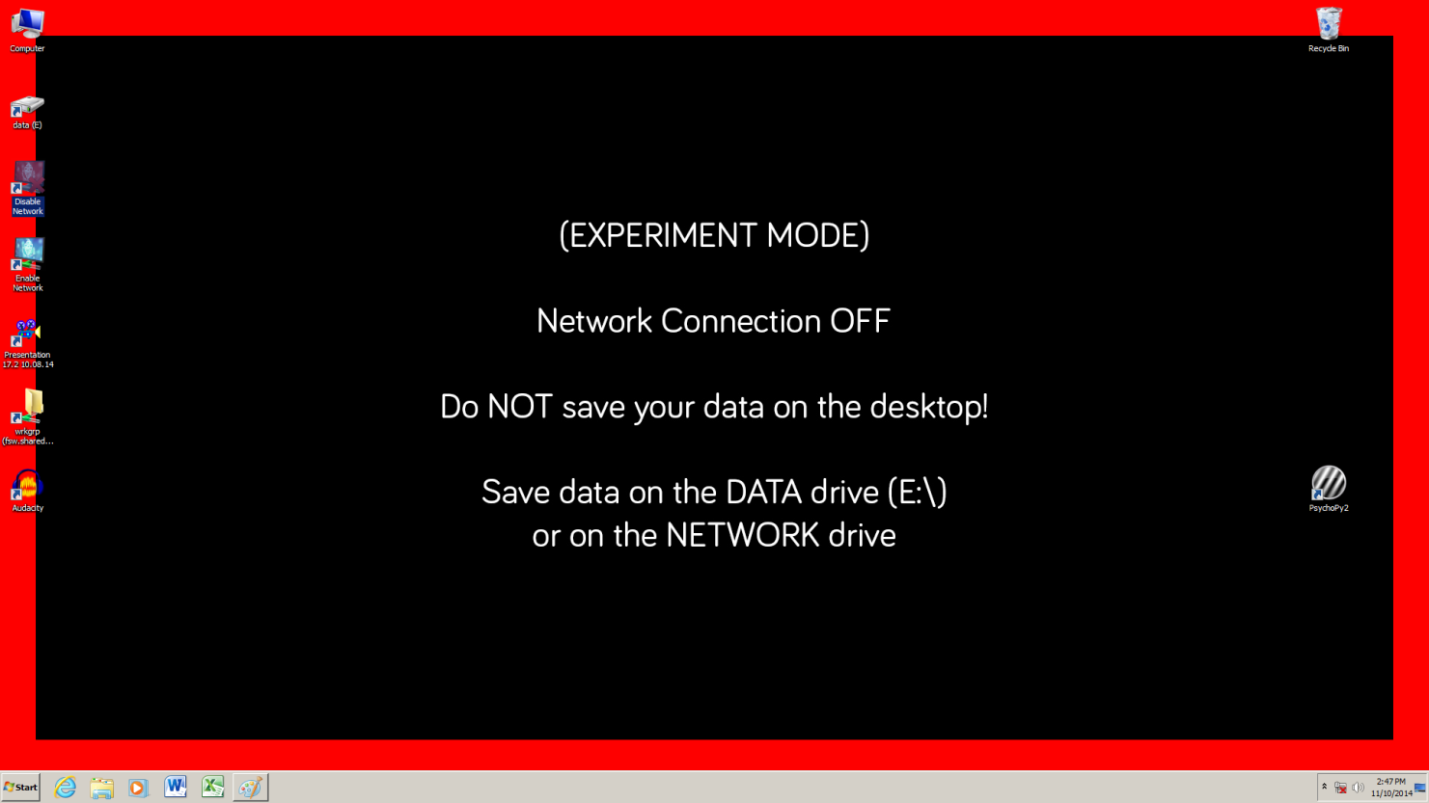
New lab computers
Windows 7
Network access
Direct access to DCC workgroup folder
Easy to backup data
Maintenance / software updates on all PCs simultaneously

Slide 3
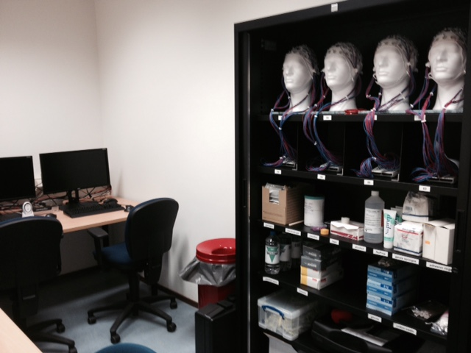
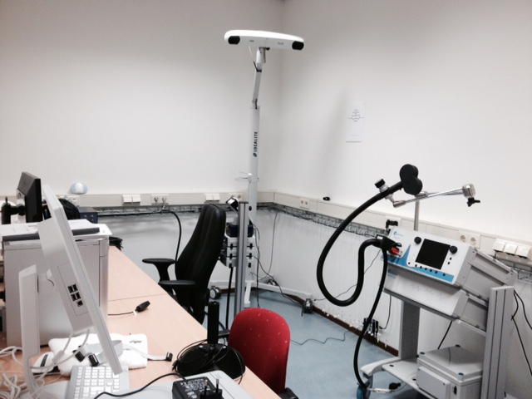
New labs and devices
TMS/EEG lab
B.00.30 / B.00.30A
No running TMS studies yet

Slide 4
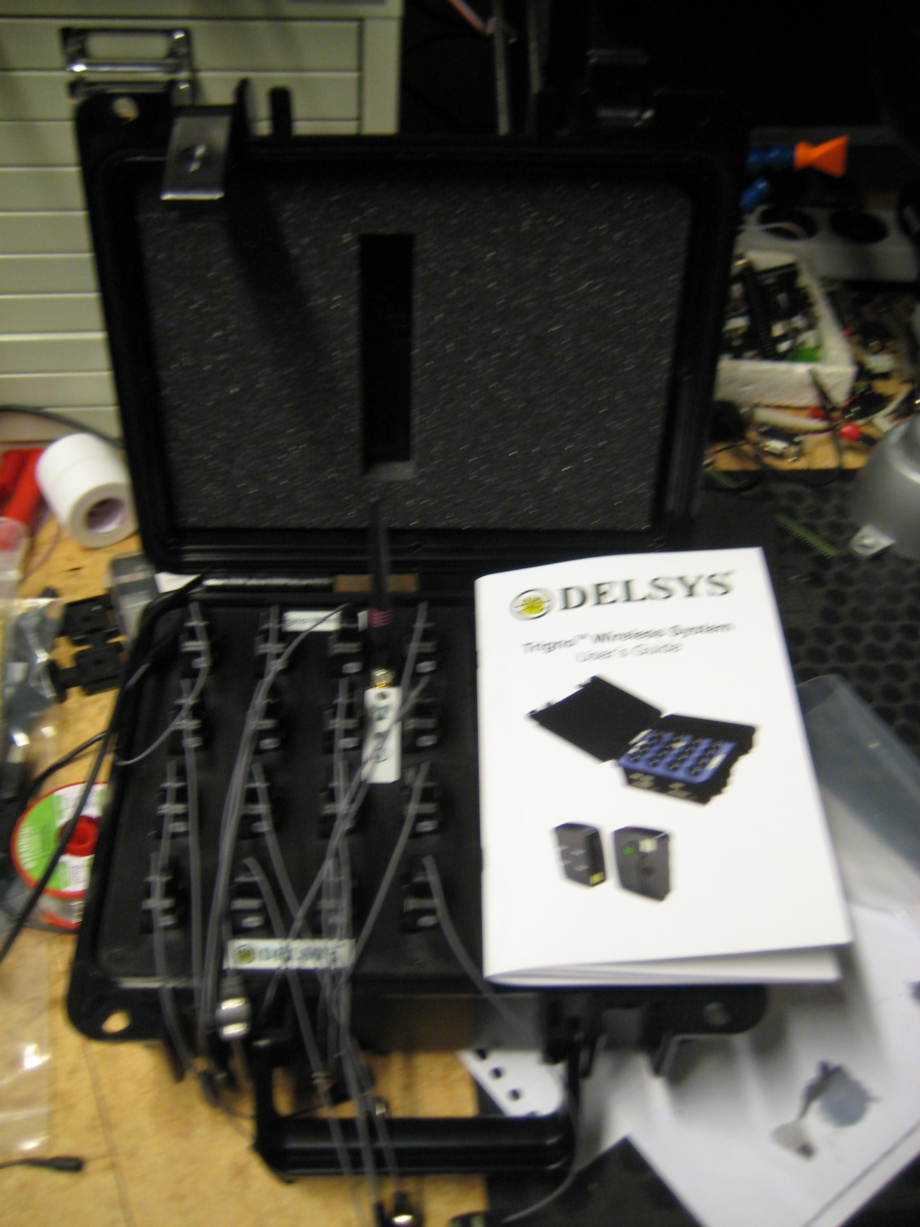
New labs and devices
Trigno 16 channel wireless EMG and accellerometers

Slide 5
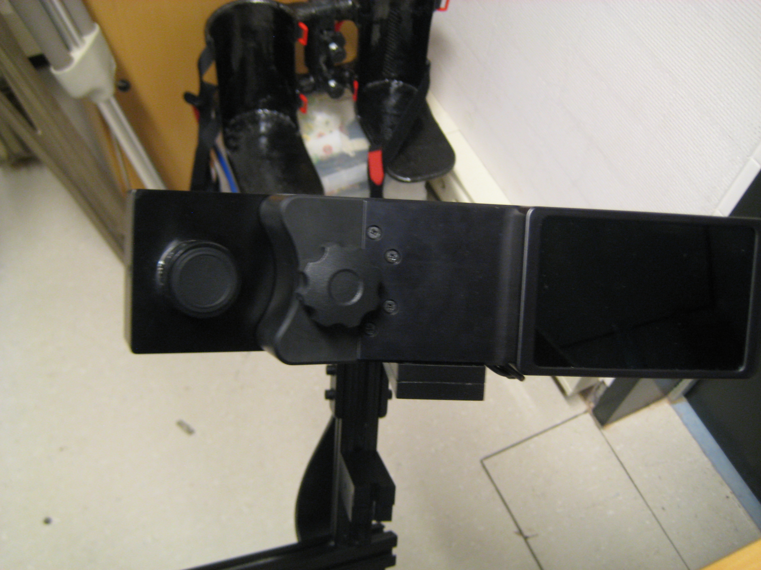
New labs and devices
SR research eyelink 1000+

Slide 6
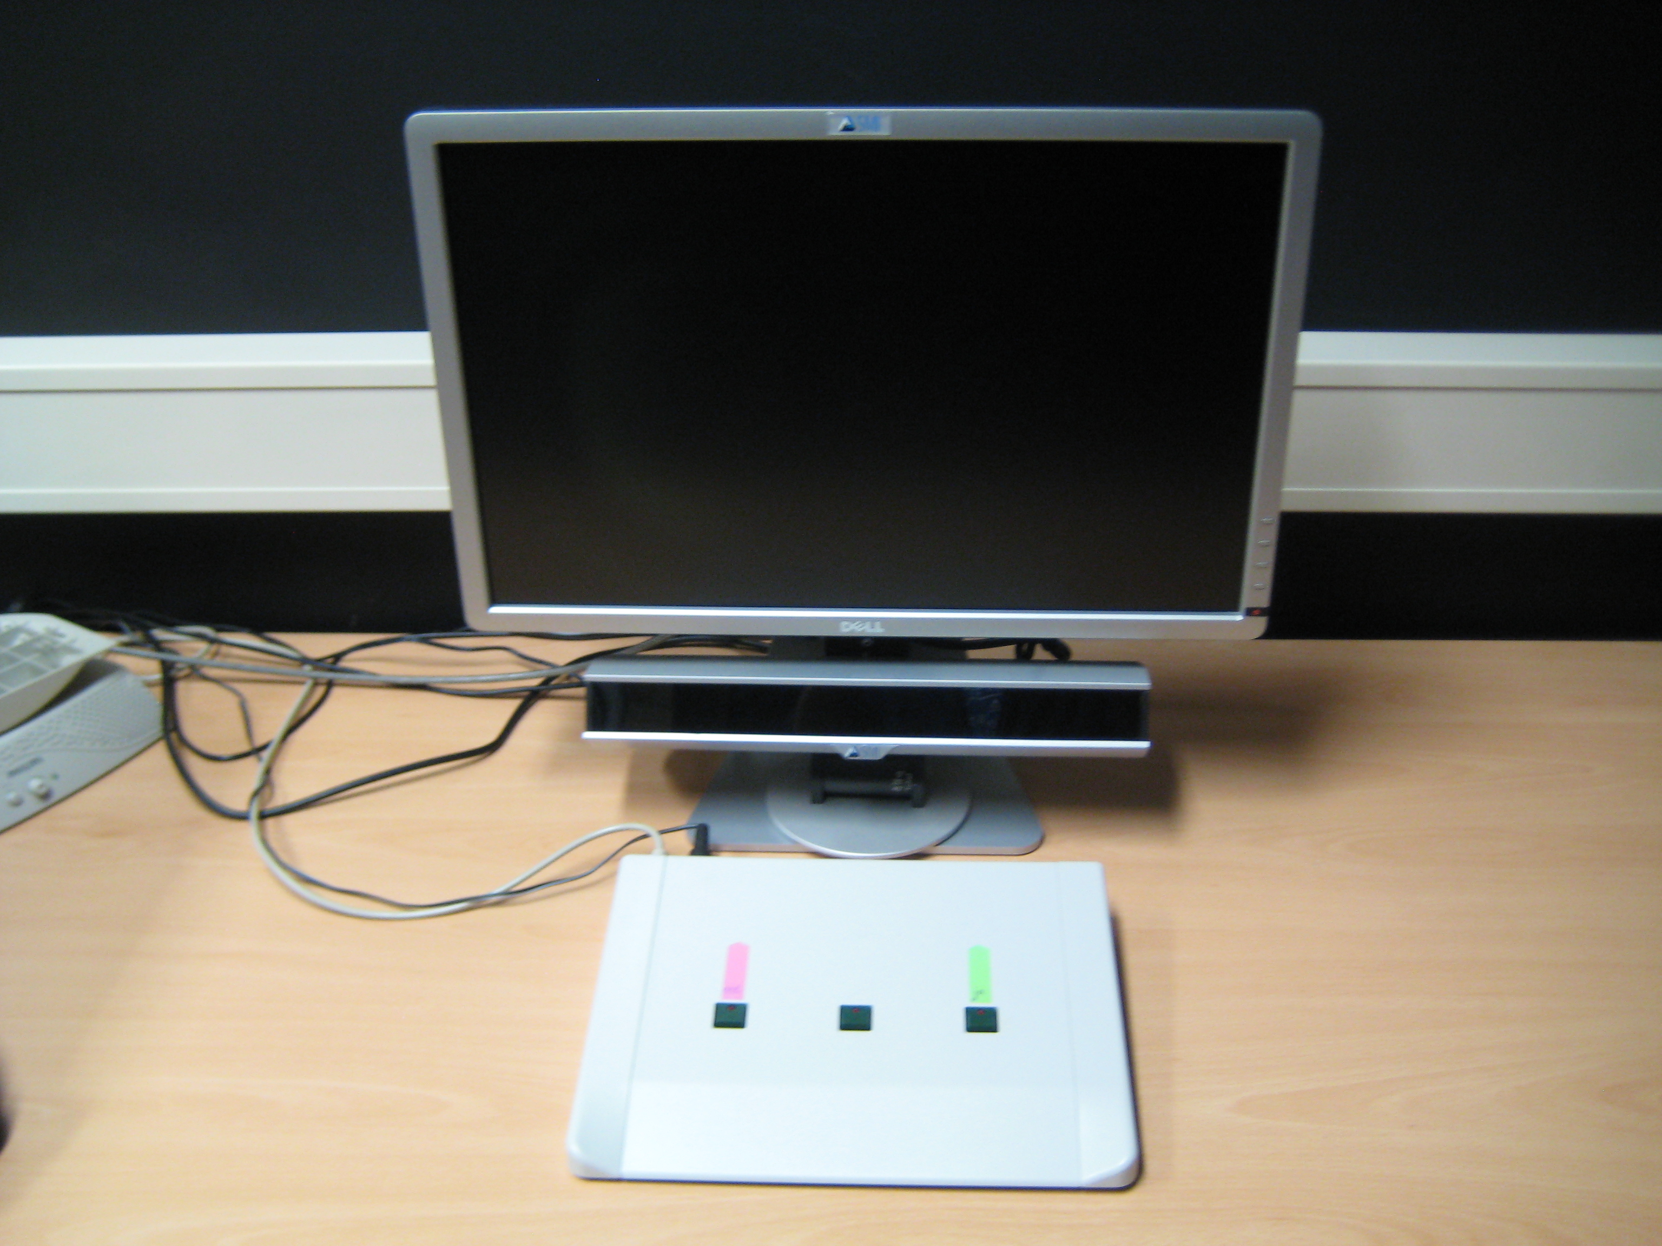
New labs and devices
Eyetracker SMI RED

Slide 7
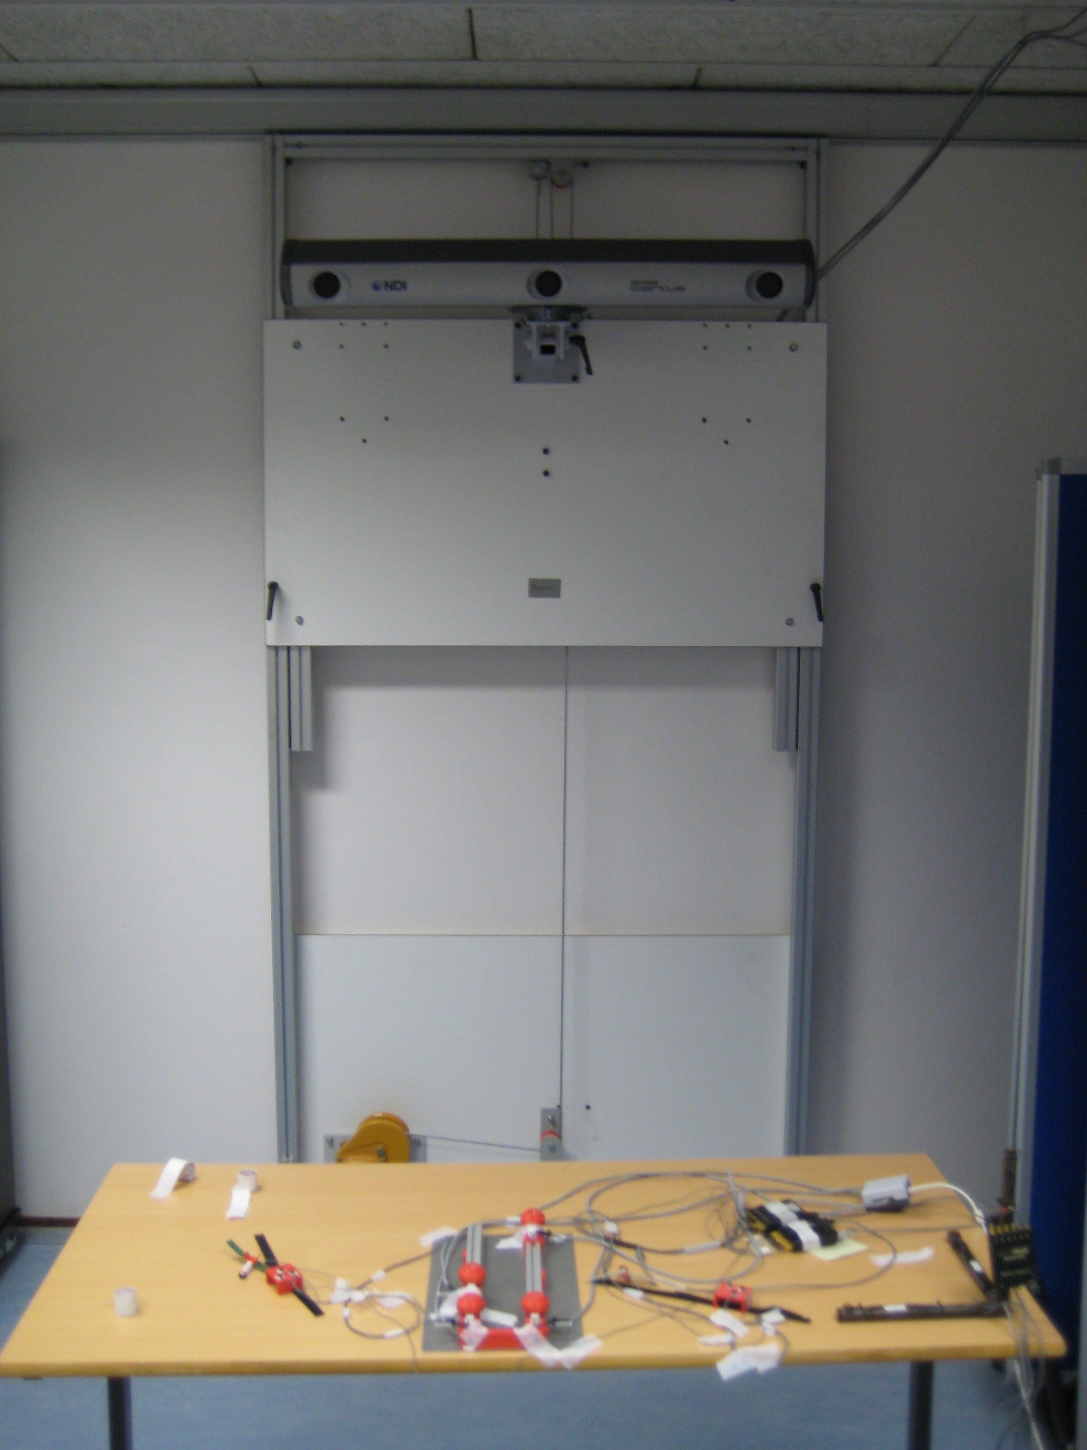
New labs and devices
NDI Optotrack Certus

Slide 8
Informed Consent Procedure
Finalized projects: Hand in consent and screening forms (original version) to lab coordinator
Forms must be filled out completely by BOTH participant and researcher
Always use the latest version of screening and consent forms
(currently: version 1.7, July 2014)
Do NOT use example forms (included in participant information packages)!

Slide 9
Hello / goodbye
Miriam Kos will return / Geertje van Bergen will leave next Monday (November 17)

Slide 10
TSG WIKI
http://tsgdoc.socsci.ru.nl/index.php/Main_Page

Slide 11
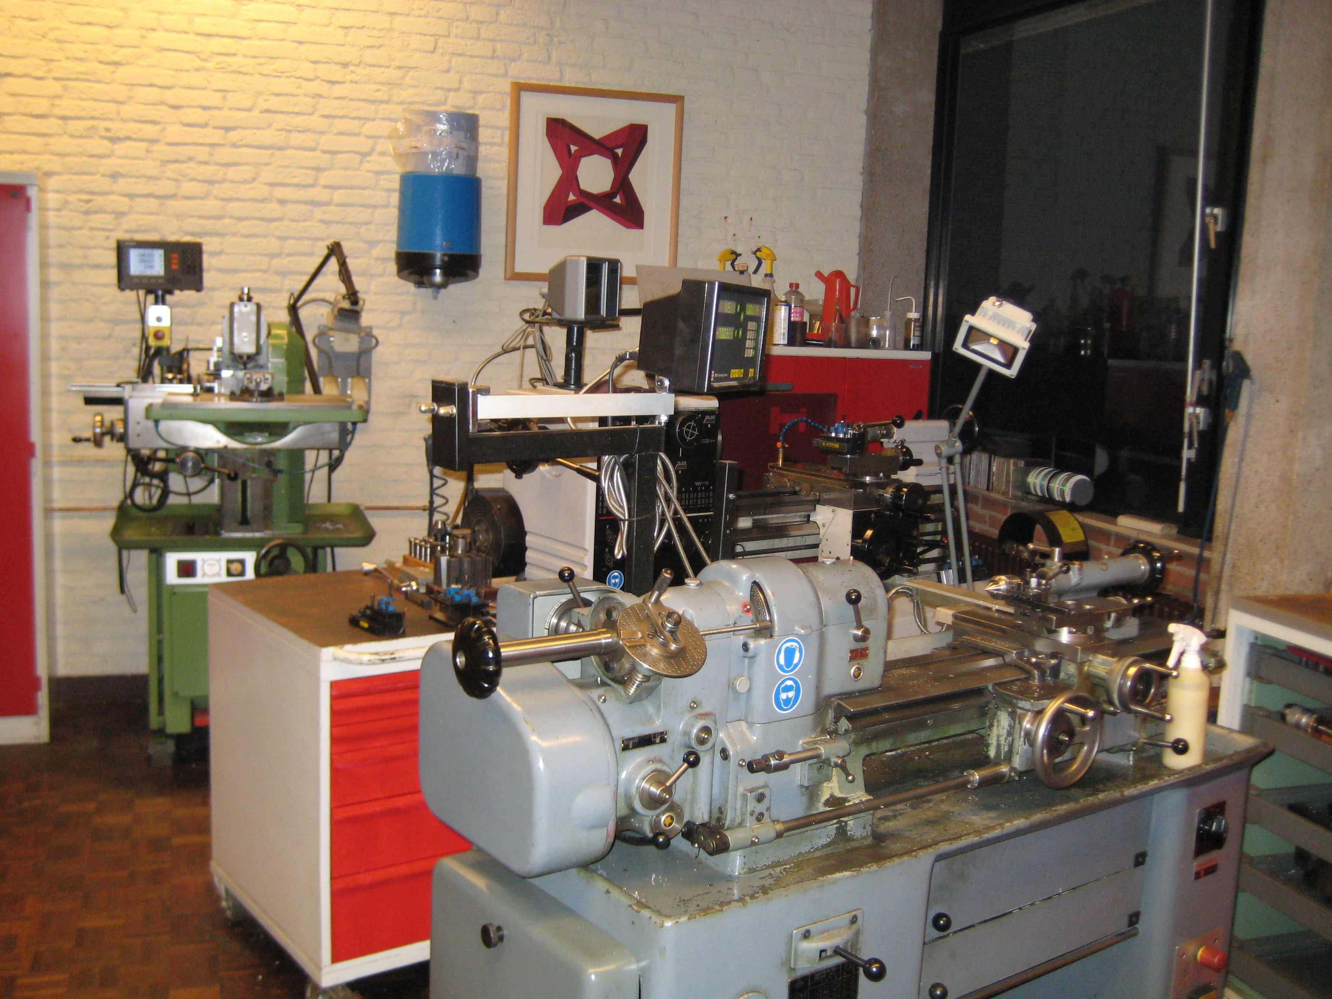
Manufacturing from old to new school
Since 1965 conventional machining

Slide 12
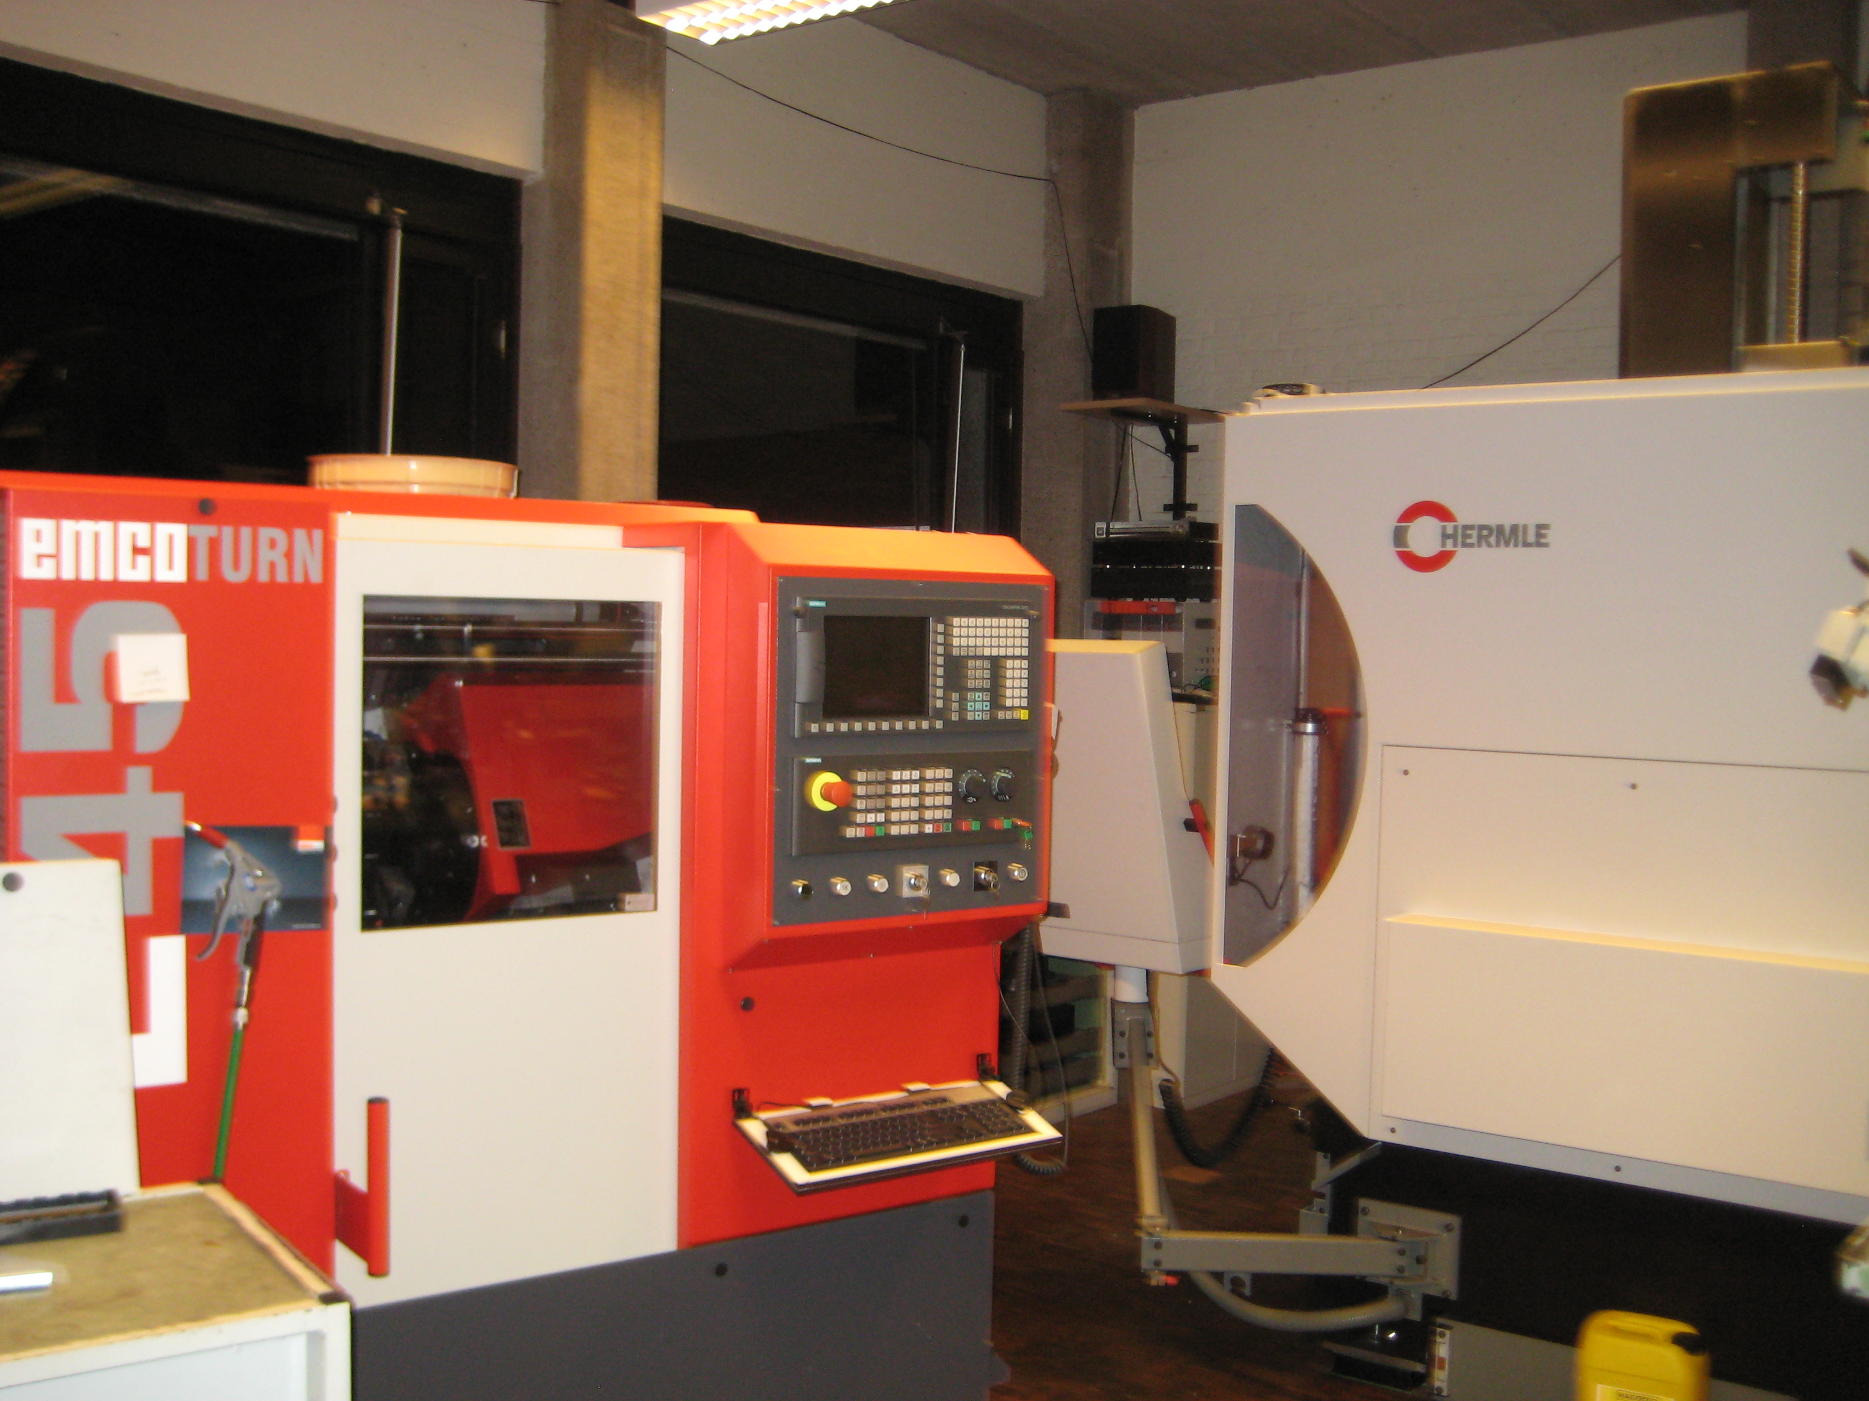
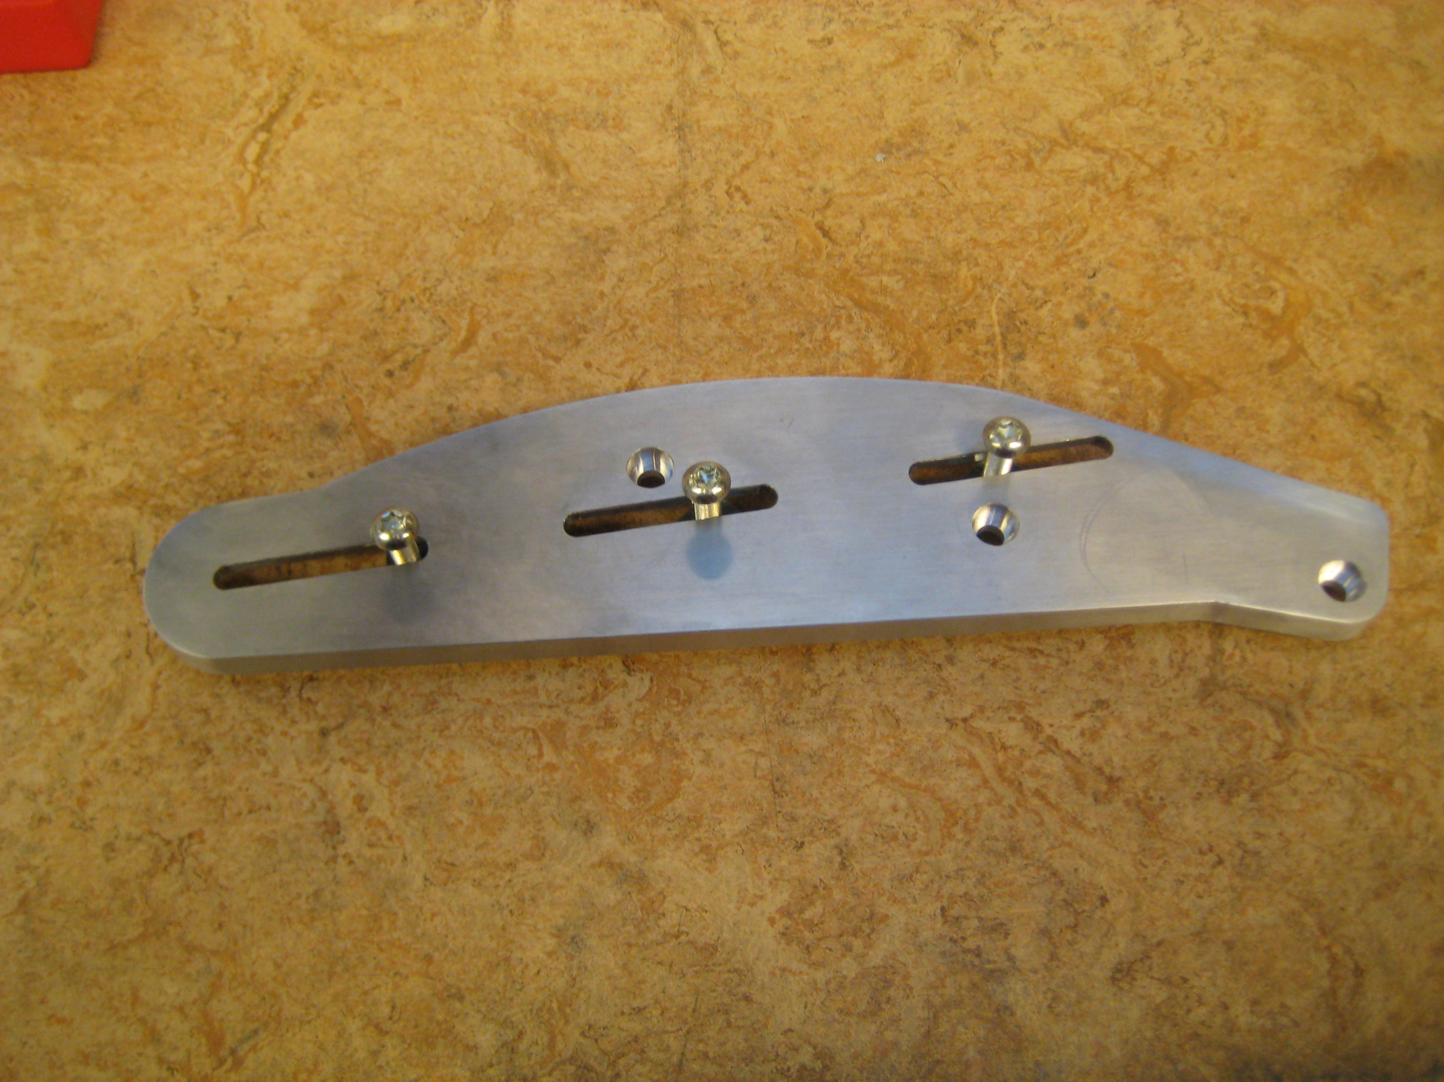
Manufacturing from old to new school
In 1999 introduction of CAD and CNC machining

Slide 13
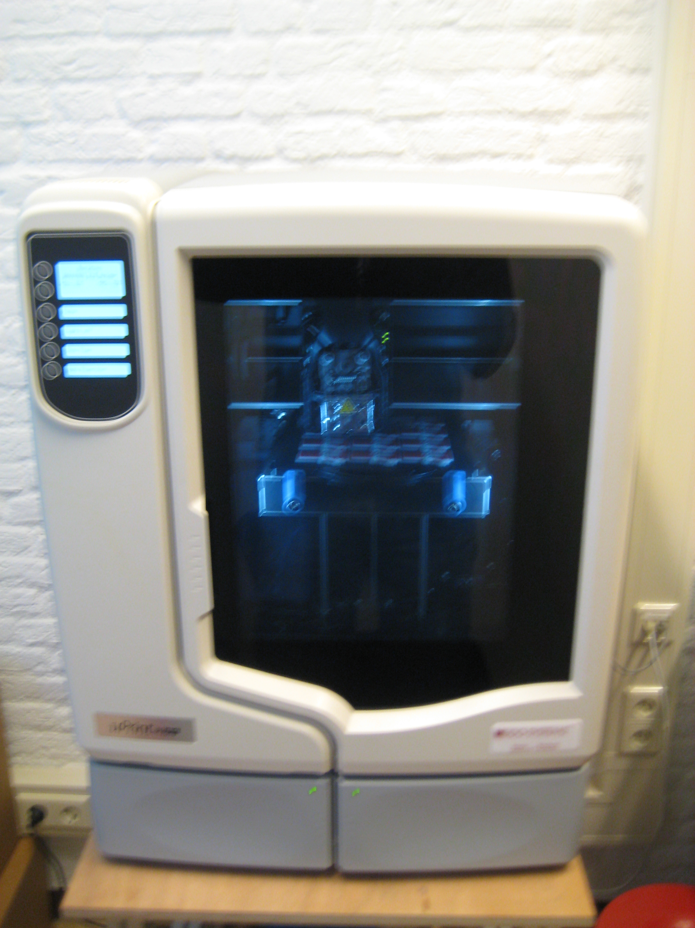
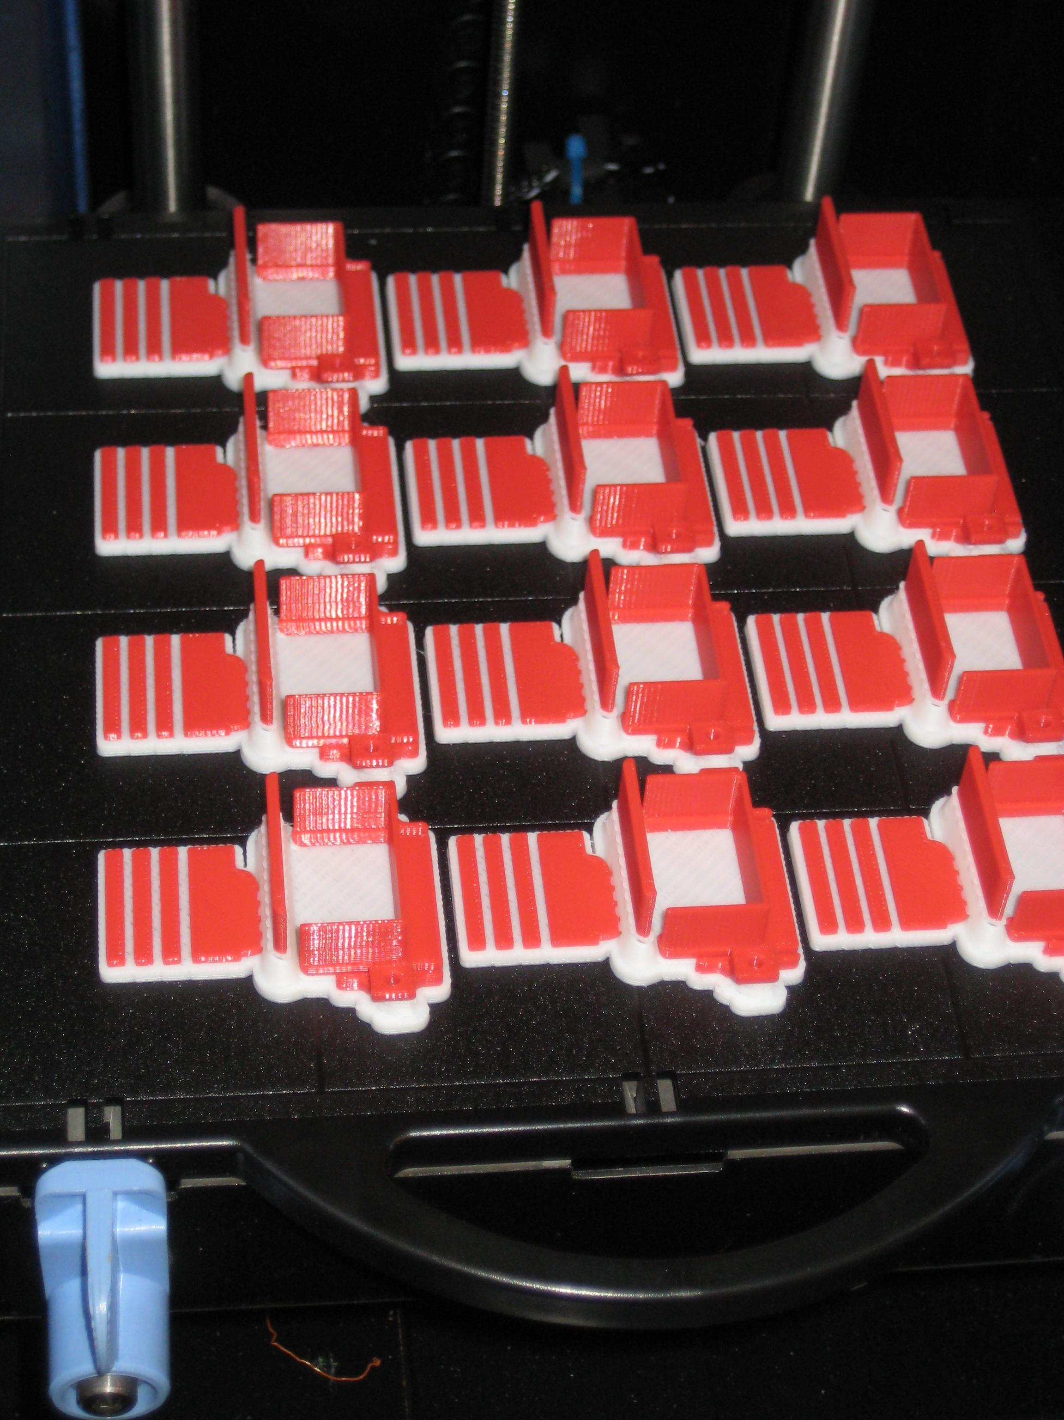
Manufacturing from old to new school
2013 innovation arrives: rapid prototyping

Slide 14
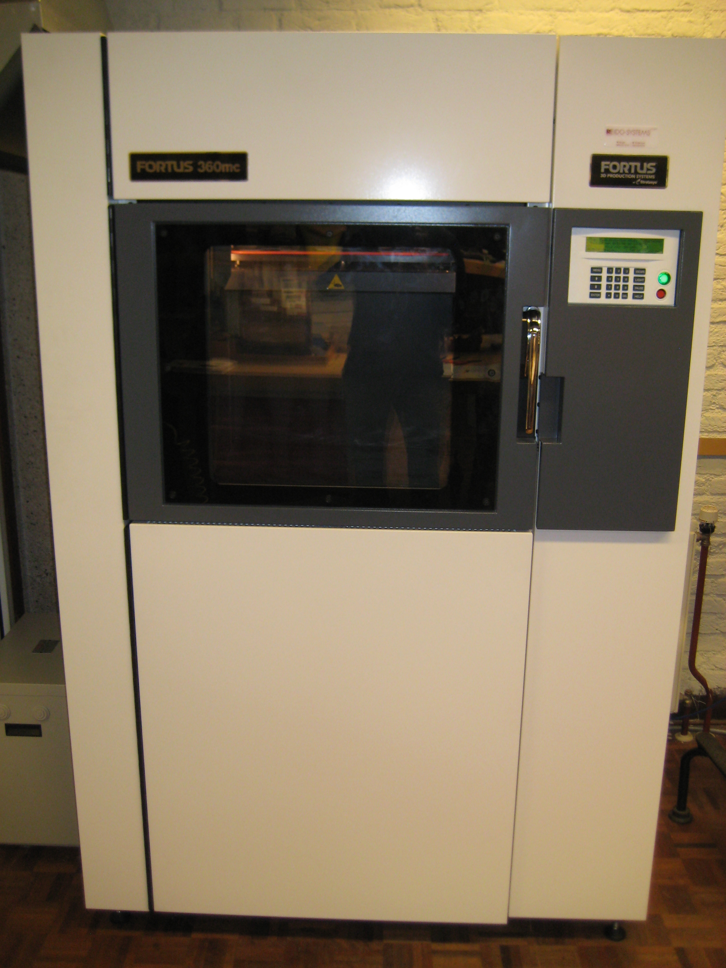
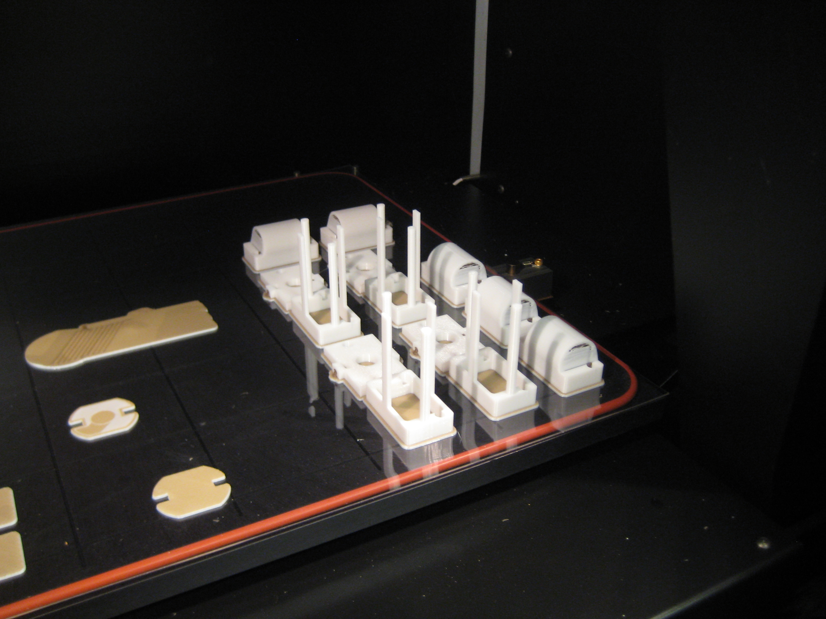
Manufacturing from old to new school
2014 the next step: different materials

Slide 15
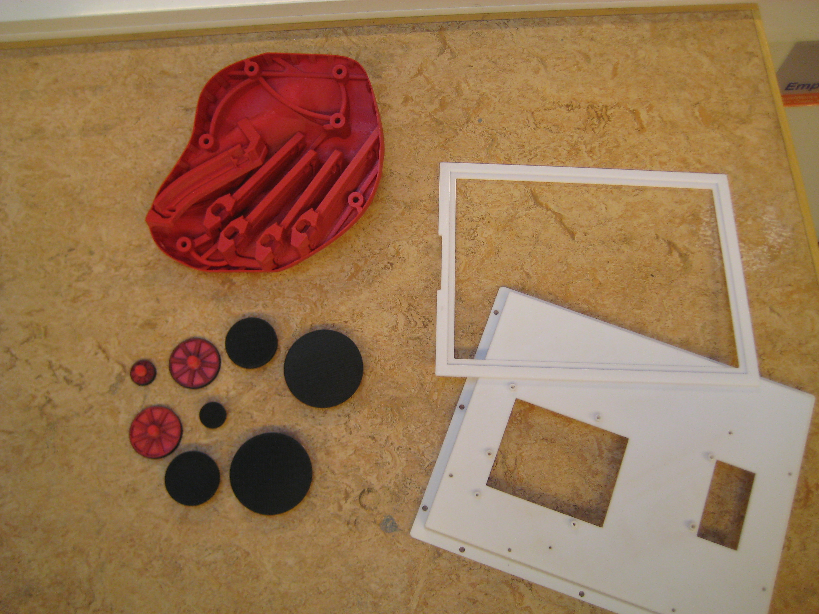
Manufacturing from old to new school
Some products

Slide 16
Programming mobile applications
Mobile applications in HTML5

